Slide 1

Data Science Bootcamp
AlgoReel

Slide 2
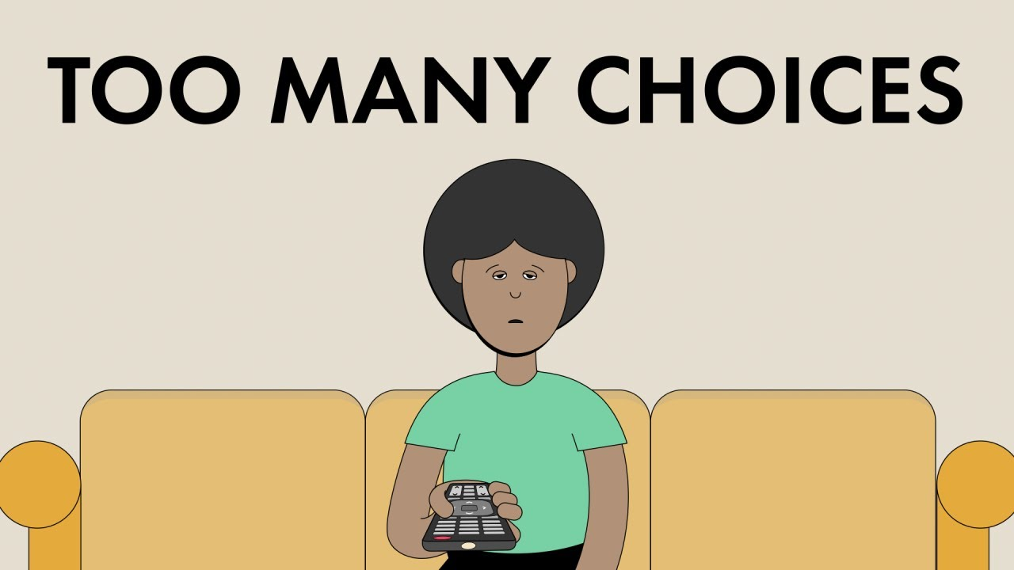
Goals
Ever spent more time choosing a movie than watching one? Yeah.. us too.
Data Science Bootcamp

Slide 3
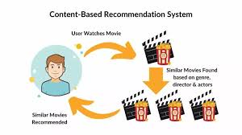
Gist of Mid-Term Presentation
What is recommendation system?
An algorithm that suggests relevant items to users.
A content-based filtering approach that understands what a user likes- based on genres, overviews and keywords and suggests similar movies they’ll actually enjoy.
Data Science Bootcamp

Slide 4
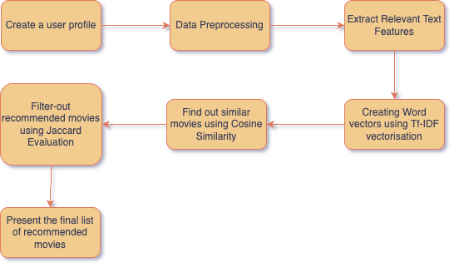
How it works?
Data Science Bootcamp

Slide 5
Explanation of Flowchart
Text Features Extracted
-Movie data like genres, plot summaries, or tags collected.
Text Vector
-Converted to TF-IDF vectors (higher weight = more relevant word).
Similarity Computation
-Cosine similarity used to measure distance angle/distance between vectors.
Top-N Recommendation
-Most similar movies are selected.
Evaluation
-Jaccard similarity used to compare how similar the recommended movie’s genres are to the input movie’s genres.
Data Science Bootcamp

Slide 6


